Slide 1
Spring Fundamentals
Emilian Marian - Software Engineer
Alexandru Babei - Software Engineer
March 2024

Slide 2
How Spring can improve your life as a programmer?

Slide 3








Agenda
What is Spring Framework 🍃
What is IoC ( Inversion of Control )
What does Spring to make our life easier
How the Spring magic works
Configure ‘The Magic’
How to configure different types of Beans
Configure Beans scope
Configure Spring with external files

Slide 4
What is Spring?

Slide 5
What is Spring?
Spring is an Inversion of Control ( IoC ) container.
What is IoC example:
Own car:
Take care of: insurance, revision, tires etc.
If you want to change it, it will take time and an extra money effort.
Rented car:
Rental agency will do this for you.
If you want to change it, it will take few days, no extra money effort.
Plain code:
You can’t decide at runtime the implementation you want to use, or it’s pretty hard to do it.
You have to take care of everything ( instantiate the class, take care of the implementation, etc. ).
IoC code:
It is easy to switch between different implementations.
It increases the modularity of the program.

Slide 6
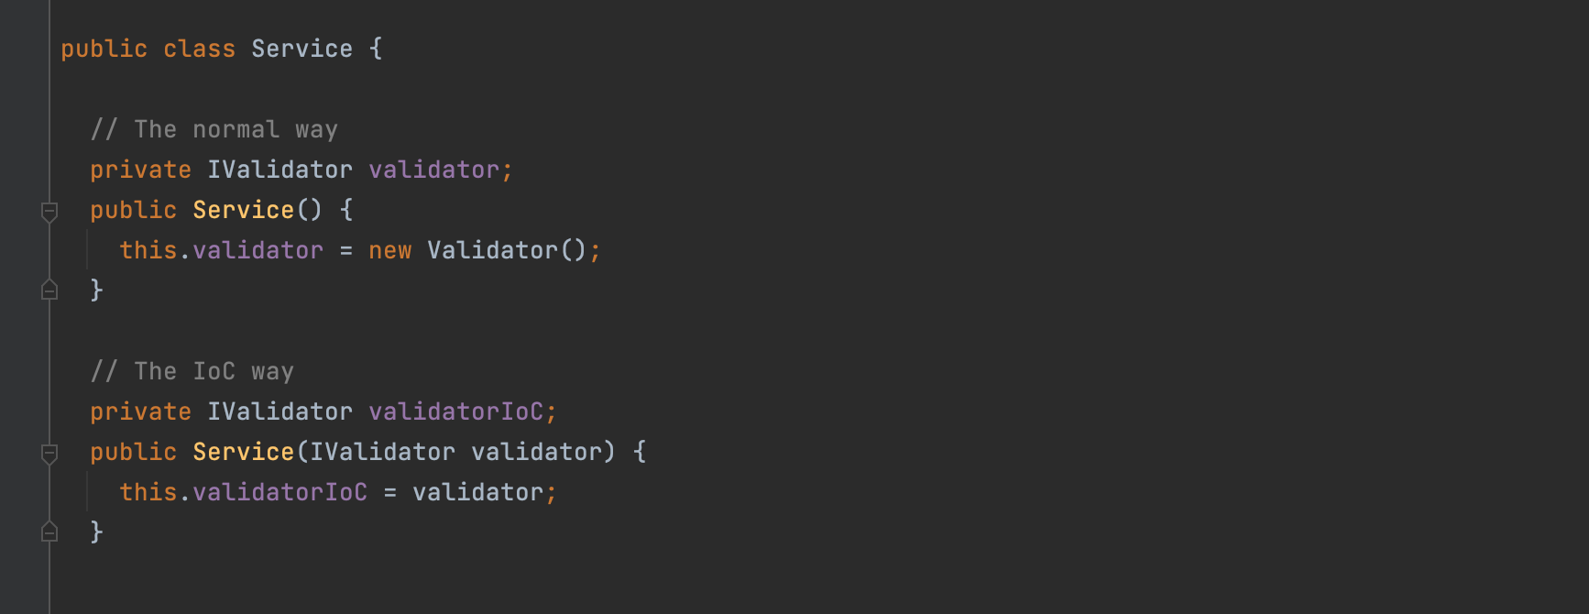
What is Spring?
IoC with Java example

Slide 7
What problem does Spring resolve and how?

Slide 8
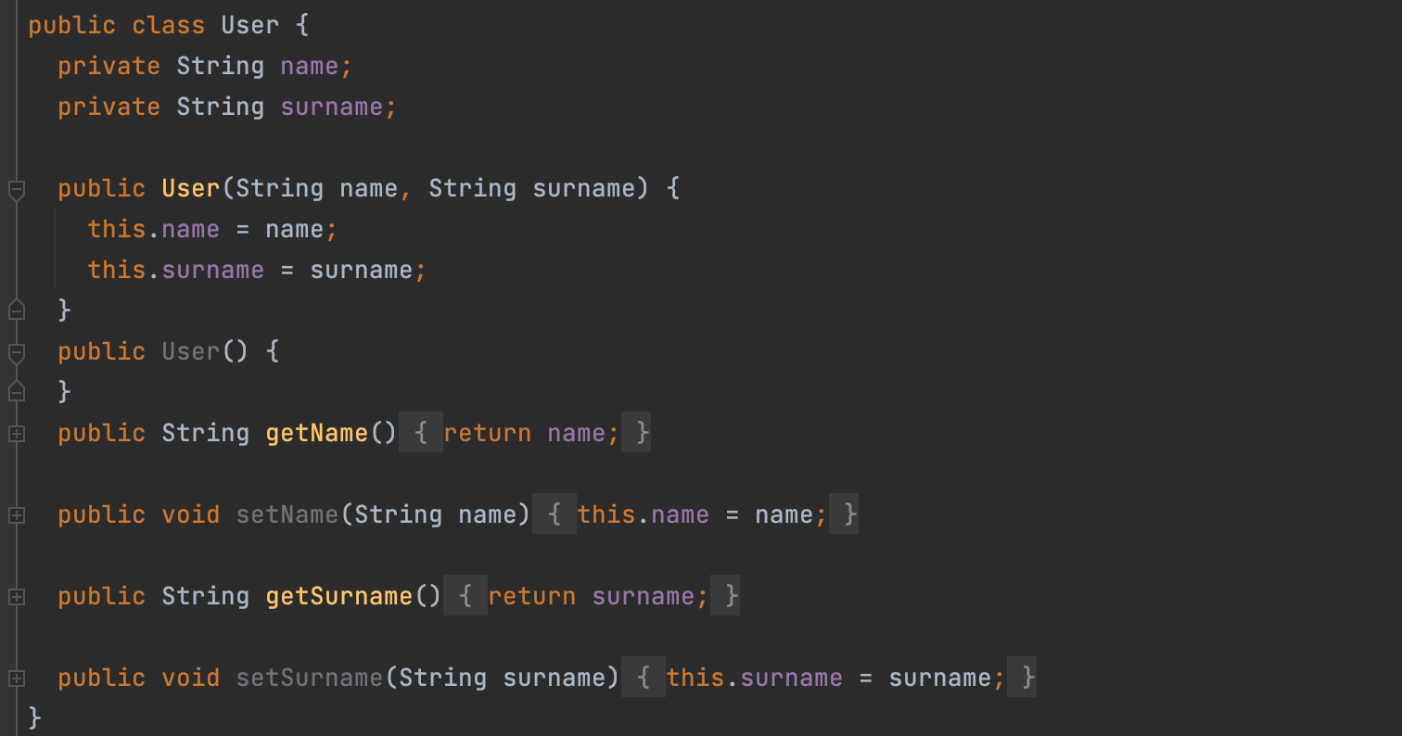
First, let’s define a model.

Slide 9
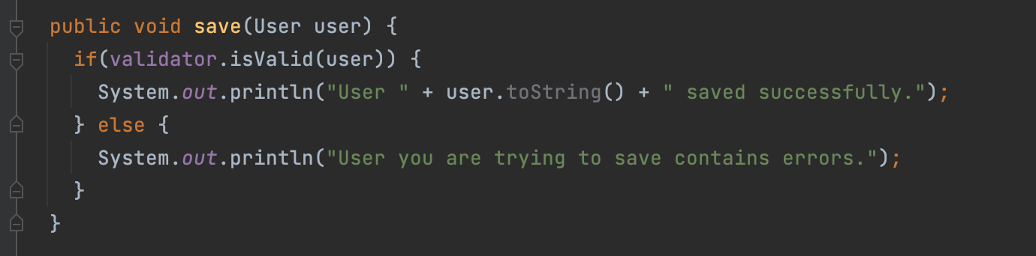
What is a dependency?

Slide 10
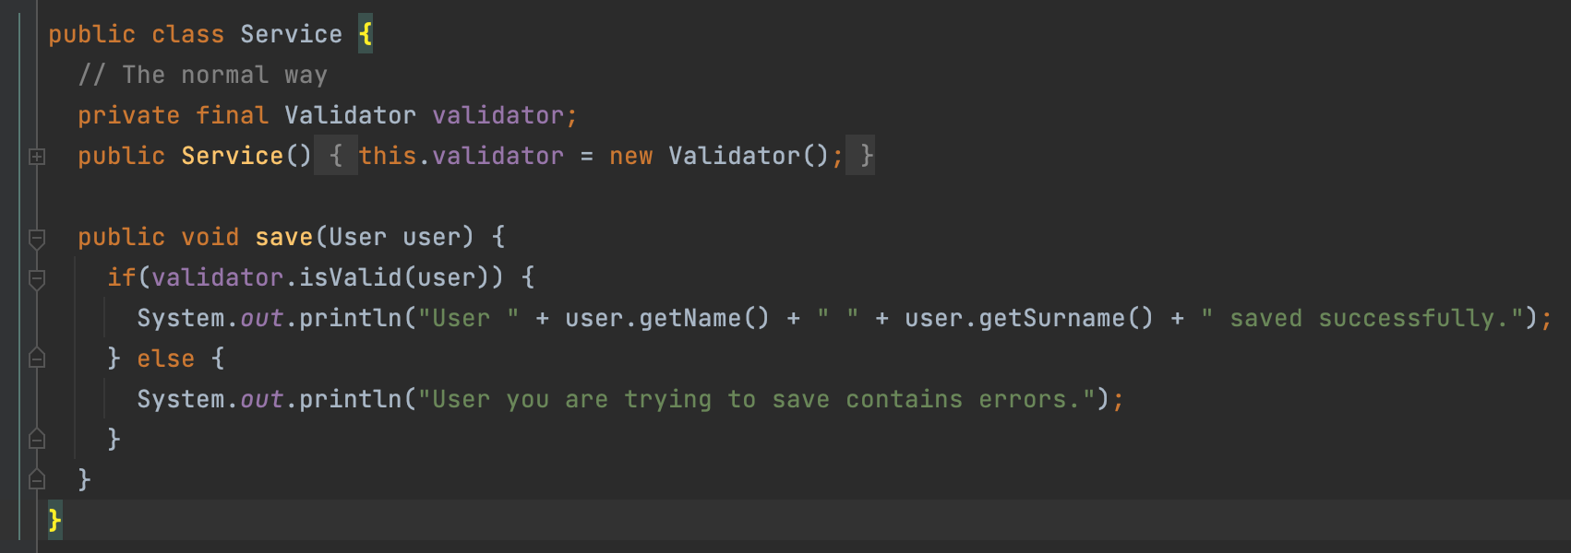
How to instantiate dependencies with new?

Slide 11
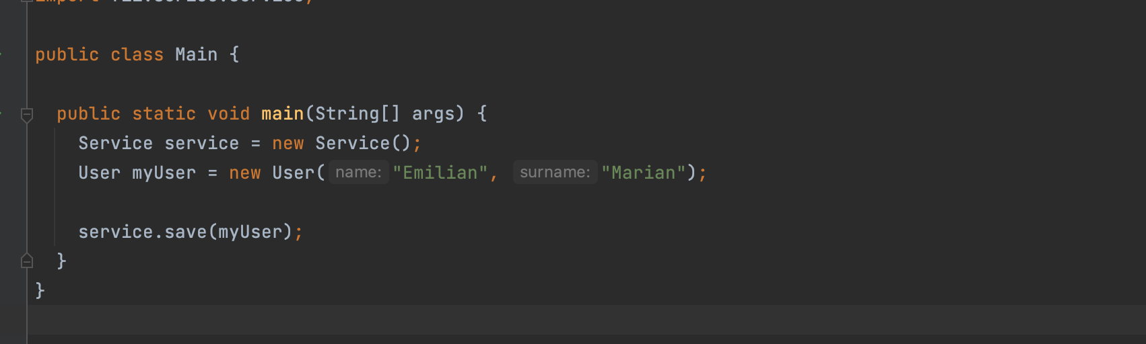
How does everything work together?

Slide 12
Advantages of using SPRING :
Increase Testability.
The code is easy to maintain.
Easy to scale the application.
Reduce code complexity.

Slide 13
How does Spring resolve this dependency problem?
It creates an ApplicationContext that:
ApplicationContext is the implementation of IoC
IoC is achieved with Dependency Injection
Manage the Beans of an application
What is a Bean?
A bean is an object that is instantiated, assembled and otherwise managed by a Spring IoC

Slide 14
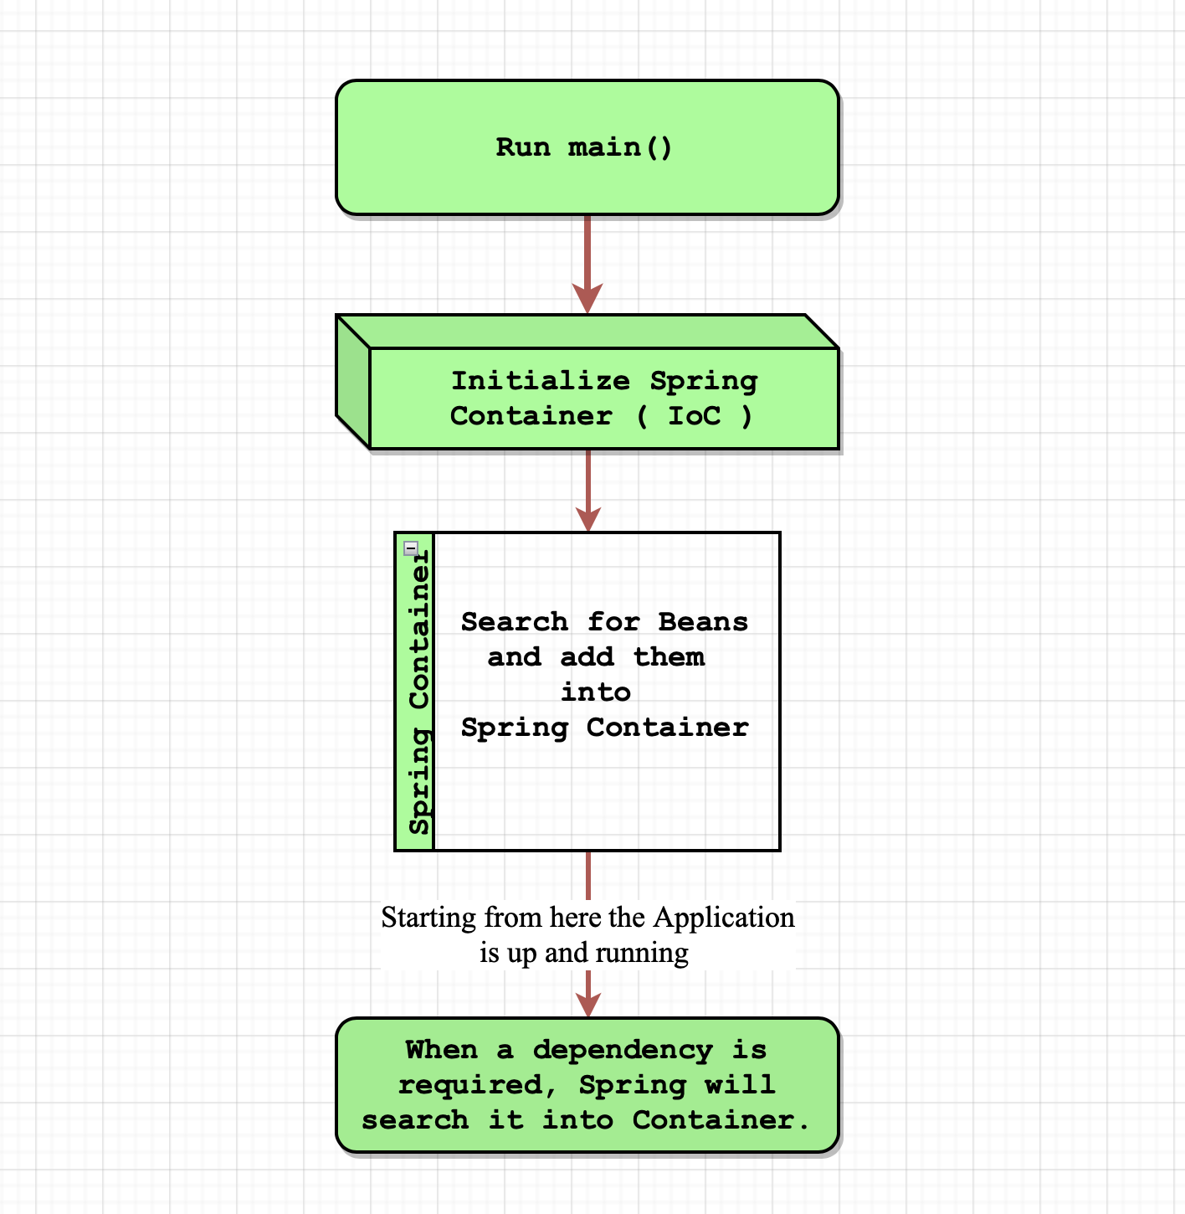
How Spring works?

Slide 15
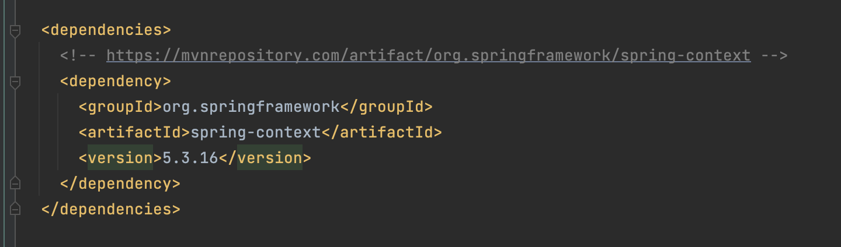
Add Spring to your project.

Slide 16
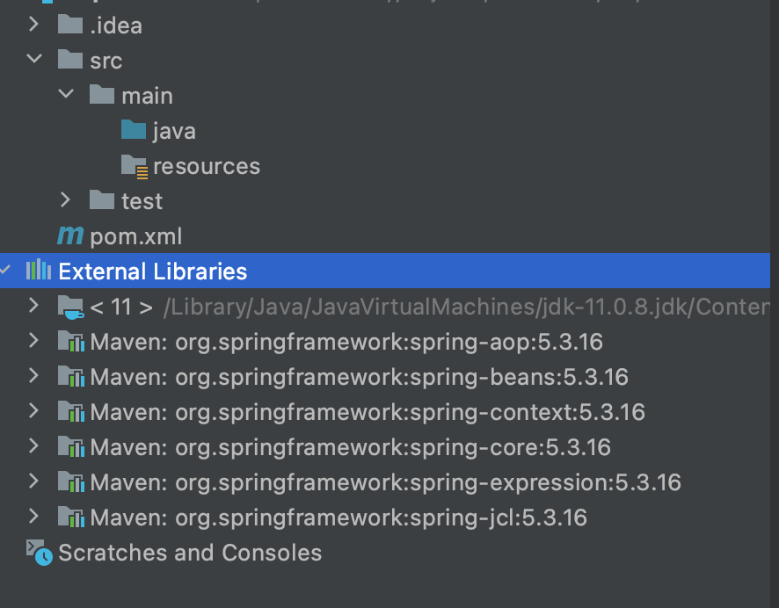
Add Spring to your project.

Slide 17
Use Spring for the code above

Slide 18
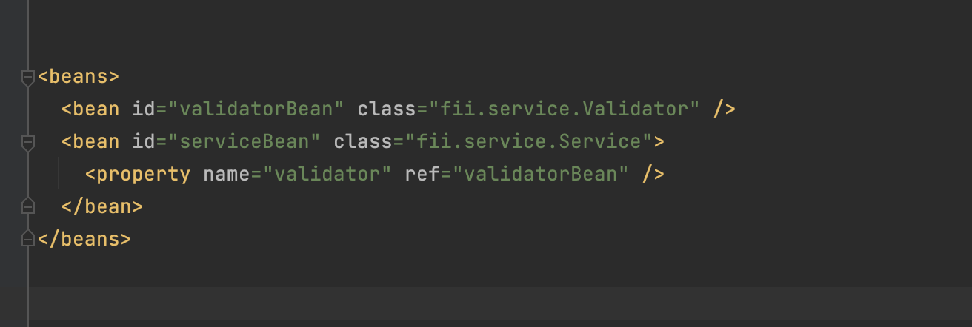
How an xml configuration file looks like?
Define ApplicationContext.xml under /resource file following the below structure.

Slide 19
Configure application with Spring
@Configuration
Indicates that a class declares one or more @Bean methods and may be processed by the Spring container to generate bean definitions and service requests for those beans at runtime
@Bean
Indicates that a method produces a bean to be managed by the Spring container.
A Bean is simply one of many objects in your application.
@Autowire
Marks a constructor, field, setter method, or config method as to be autowired by Spring's dependency injection facilities.

Slide 20
Configure application with Spring
@ComponentScan
With this annotation we can tell Spring where to search for classes annotated with @Bean, @Service, @Component or @Repository:
@Component - is a generic stereotype for any Spring-managed component.
@Service - annotates classes at the service layer.
@Repository - annotates classes at the persistence layer, which will act as a database repository.

Slide 21
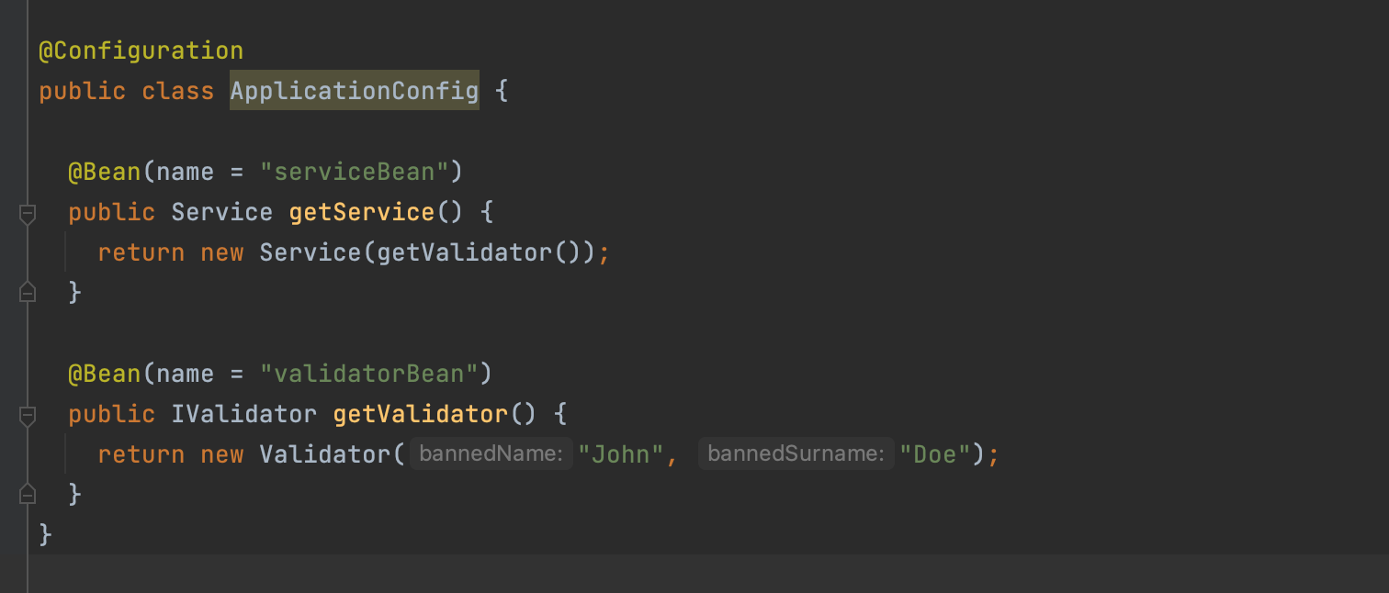
Configure application with Spring

Slide 22
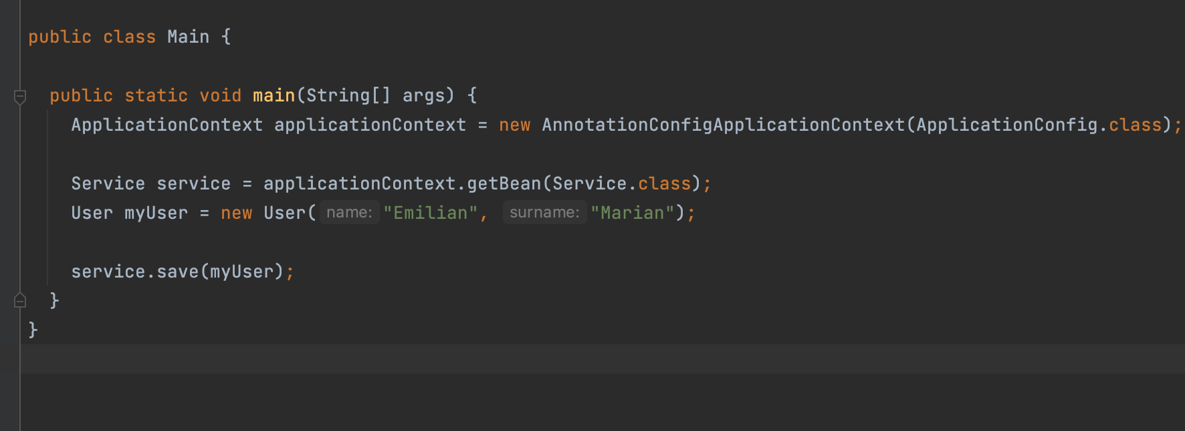
Configure application with Spring

Slide 23
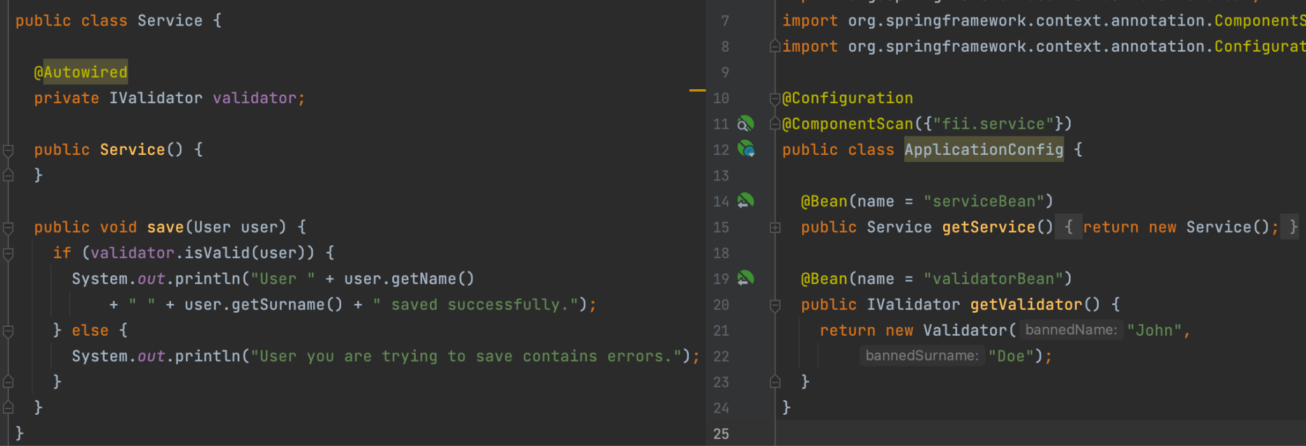
Configure application with Spring

Slide 24
Let’s make some examples together 🥳

Slide 25
Spring bean scopes

Slide 26
Bean scopes
The latest version of the Spring framework defines 6 types of scopes:
singleton
prototype
request
session
application
websocket
Request, session, application and websocket scopes are only available in a web-aware application.

Slide 27
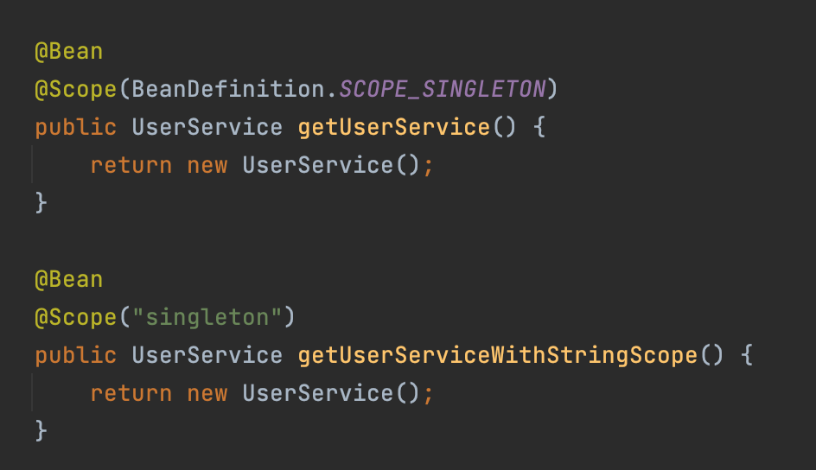
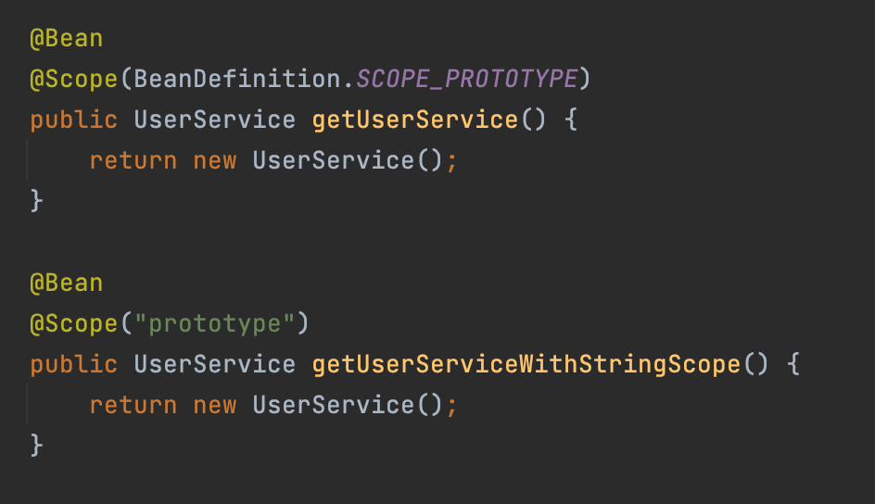
Bean scopes
Singleton
Prototype

Slide 28
Spring configurations

Slide 29
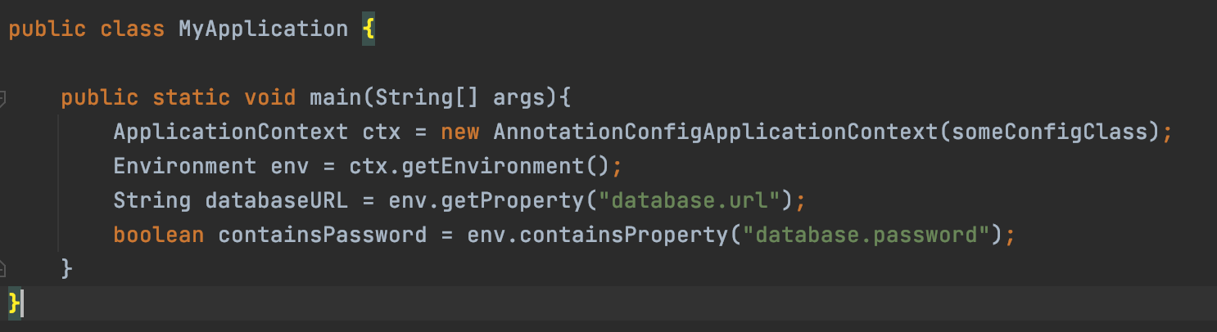
Environment properties

Slide 30
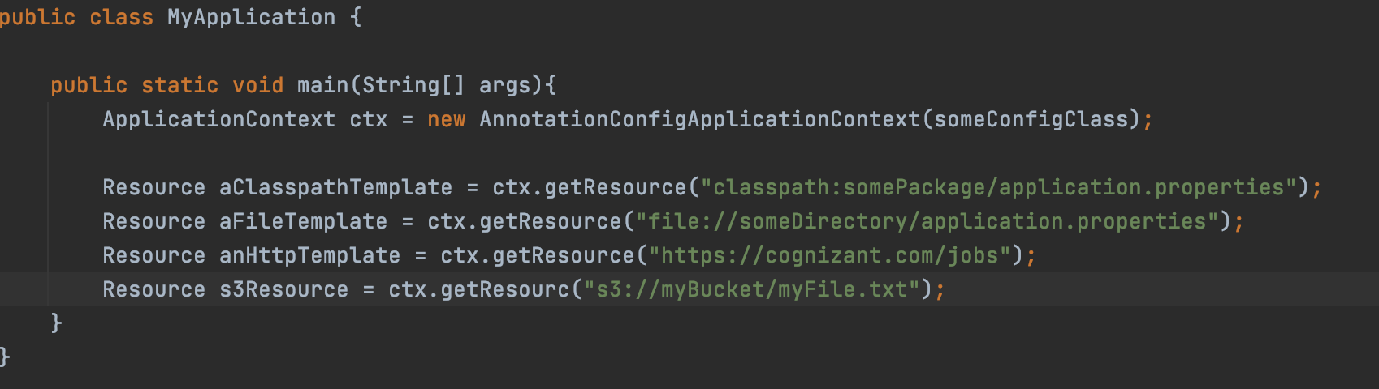
Resources

Slide 31
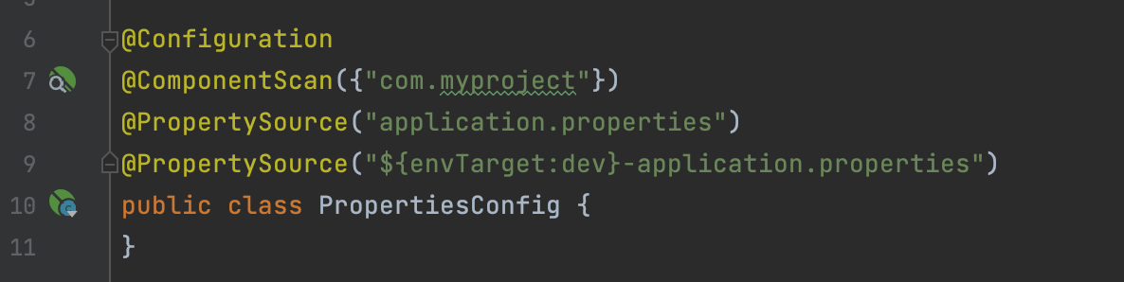
Property sources
Spring 3.1 introduced the @PropertySource annotation as a convenient mechanism for adding property sources to the environment.
Another very useful way to register a new properties file is using a placeholder, which allows us to dynamically select the right file at runtime
The @PropertySource annotation is repeatable according to Java 8 conventions. Or you can use the @PropertySources annotation and specify an array of @PropertySource.

Slide 32
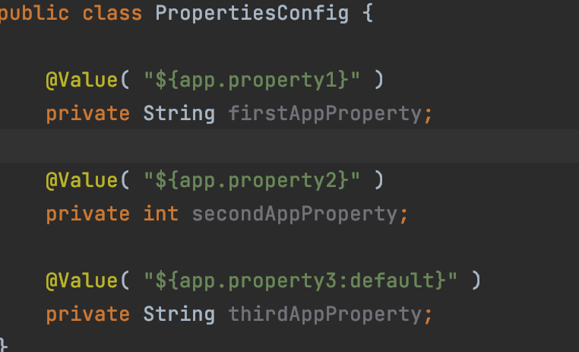
Using/Injecting Properties
Injecting a property with the @Value annotation is straightforward
You can also specify a default value for the property

Slide 33
Let’s make some examples together 🥳

Slide 34
Now, we know you can do it!

Slide 35
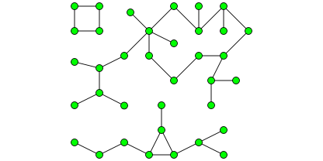
Exercise
Below you will find some tasks in a random order. Once everything it's tight together, Spring will do the magic.
1. Create a simple Java class PaymentCreationServiceImpl representing a service.
2. Define an interface PaymentCreationServiceInterface for the service with one method called createPayment().
3. Use Spring to inject PaymentService and PaymentHistory dependencies into a new class named Processor.
4. Configure beans with Annotations into PaymentConfiguration
5. In the processor, inject one dependency in the constructor and another one with @Autowire.
6. Create one main class where you can test createPayment().
7. Create a PaymentHistory class with a method in it.
8. Inject a property called `app.history.type` in PaymentHistory from application.properties and print it in the method you created.
9. Annotate all the classes with the required annotation and make your application scan for all the beans.
10. Now that everything works, you can test @Component, @Service, @Repository or you can change the @Scope, or also, you can inject your dependency in the setter.

Slide 36


Thank you
Emilian Marian
https://www.linkedin.com/in/emilian-marian-48535a6b
emilian.marian@cognizant.com
Alexandru Babei
alexandru.babei@cognizant.com

